Slide 1
Review of CAR 143913017

Slide 2
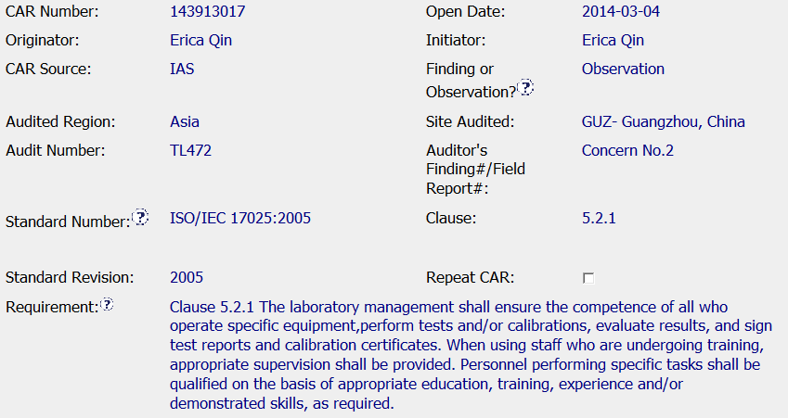

Includes all of the required background info
Was an ambient TC required or is environmental monitor sufficient?

Slide 3
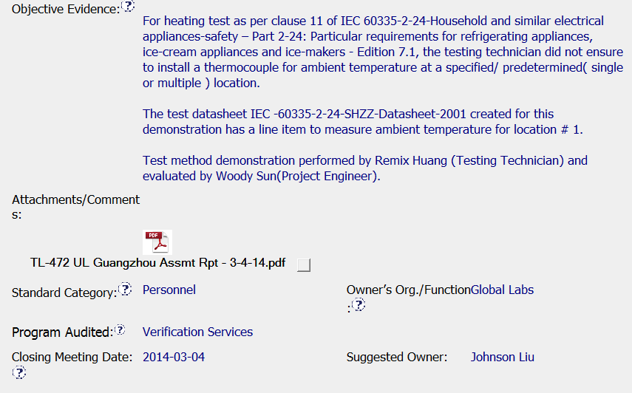
Unclear if the ambient was recorded at all or if the auditor was specifically looking for a TC to measure ambient in the test setup
Suggest removing names and noting employee ID instead
Good that assessment report was included

Slide 4
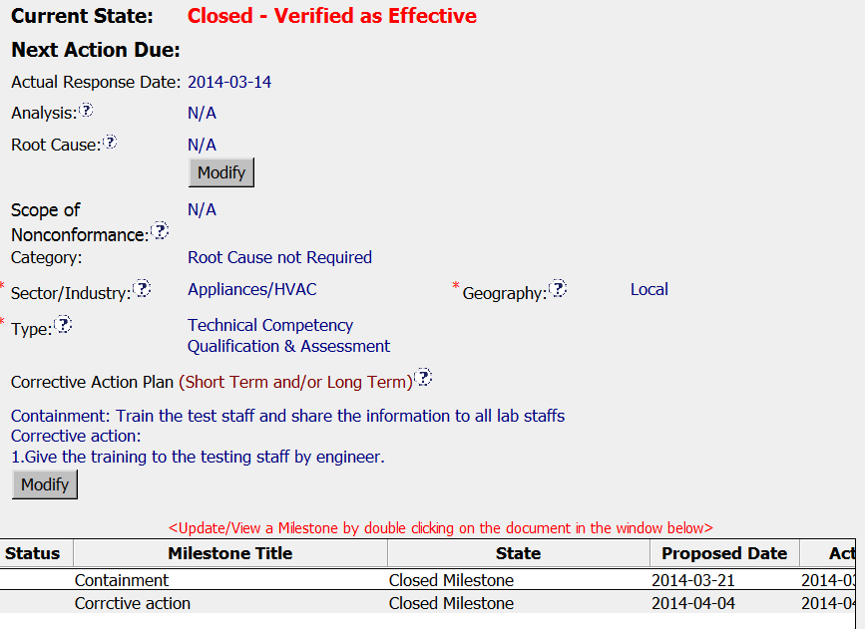
Items are N/A as expected for OBS
Correct category for OBS
Correct type
Two steps of training the testing staff in Containment and CA. Difference is not clear from the CAP. Check milestones

Slide 5
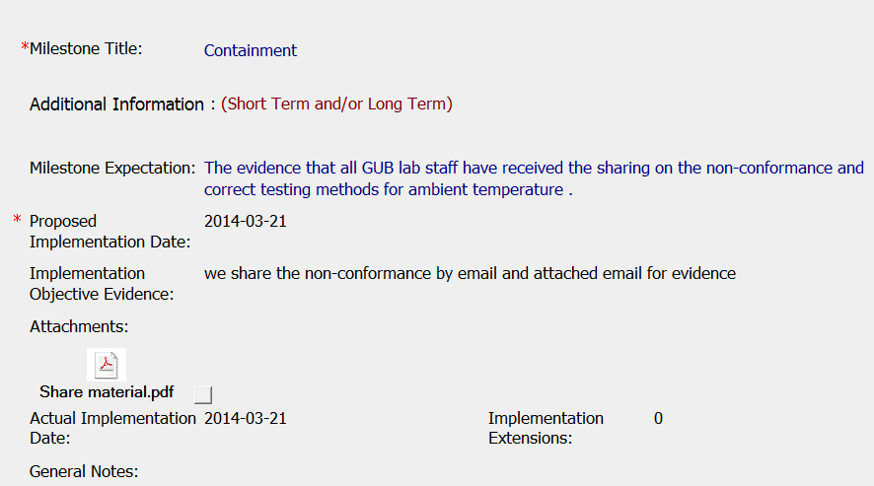
Communication to staff regarding ambient data recording. Suggest including confirmation of understanding in addition to the outgoing message.

Slide 6
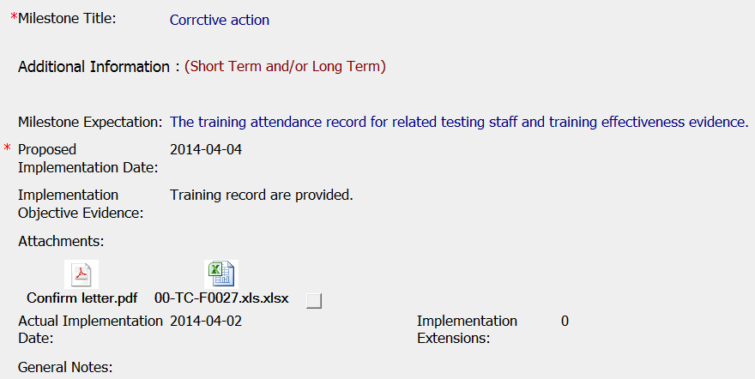
Training record and confirmation letter attached as evidence

Slide 7
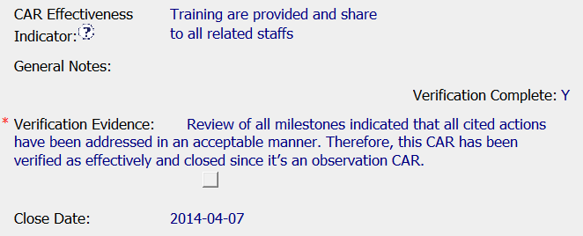
CAR effectiveness indicator & evidence fields completed
Verification completed on the same day that the CAR was closed (4-7-14)

Slide 8
Summary:
Overall, few suggestions for improvement, but handled well as an observation. Timely – opened and closed in about 1 month
Food for thought:
Should auditor have categorized it as a finding or an observation?
How would we write it?
If we were the quality rep, would we push back if it was categorized as a finding?

Slide 9
